Slide 1
Smoke control fundamentals design & testing 101 presented at the 54th ANNUAL CAFAA CONFERENCE FEBRUARY 9, 2024
Mark McQuaid
H.R. Kirkland Co.

Slide 2
Smoke control system definition
The 2022 California Building Code (CBC), based on the 2021 International Building Code, defines a smoke control system in Section 909.1
A system consisting of fans, dampers, and smoke barriers designed to provide a tenable environment for the evacuation or relocation of occupants
It is not intended for the preservation of contents, the timely restoration of operations or for assistance in fire suppression or overhaul activities

Slide 3
Applicable codes/standards
2022 California Building Code (CBC), Section 909
Omits maintenance requirements
2022 California Fire Code (CFC), Section 909
Maintenance requirements listed in Section 909.22
NFPA-92, Standard for Smoke Control Systems
Referenced standard for air flow and exhaust means of mechanical smoke control
Underwriters laboratories, UUKL, Smoke Control System Equipment
Includes requirements of ANSI/UL 864 Control Units for Fire-Protective Signaling Systems

Slide 4
where required
Covered mall buildings with atriums
CBC, Section 402.7
High-rise buildings
CBC, Section 403.4.7
Atriums
CBC, Section 404.5
Underground buildings
CBC, Section 405.5
Group I-3 Windowless Buildings
CBC, Section 408.9
Large stages
CBC, Section 410.2.7

Slide 5
Design requirements
Design starts with a Rational Analysis (Smoke Control Report) required by CBC, Section 909.4
Prepared by a member of the design team (Typically a fire protection or mechanical engineering firm)
The rational analysis accompanies construction documents and supports:
Types of systems to be employed
Methods of operation (passive or mechanical)
Construction methods
Sequence of Operations

Slide 6
Design requirements
Types of Smoke Control Systems
Passive
Mechanical

Slide 7
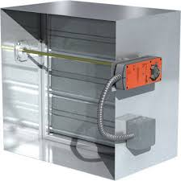
Passive smoke control cbc section 909.5
Fire Doors
Fire/Smoke Damper

Slide 8
Passive smoke control cbc section 909.5
Openings protected by automatic-closing devices
Fire doors with door hold-open devices
Fire and smoke dampers
Activated by controls described in the rational analysis, including:
Smoke/heat detectors (fire doors and some dampers)
Duct mounted smoke detectors (fan shutdown and dampers)
Not required to meet verification (positive status) requirements of CBC Section 909.12.1
Subject to interpretation

Slide 9
mechanical smoke control Pressurization cBC 909.6

Slide 10
mechanical smoke control Pressurization
Pressurization - CBC Section 909.6
Primary means of mechanical smoke control
Tenable environment not required in in the zone of origin.
Creates pressure differences across smoke barriers (typically 0.05” water gage)
Maximum pressure difference limited by emergency door opening forces (30 pounds to set a door in motion and 15 pounds to fully open an emergency exit door)

Slide 11
mechanical smoke control Exhaust CBC 909.8

Slide 12
mechanical smoke control exhaust
Exhaust - CBC Section 909.8
Used for large enclosed spaces, such as atriums or malls
Must obtain prior approval from Authority Having Jurisdiction
Design in accordance with NFPA 92 is required
System must maintain the smoke layer at least 6 feet above the highest walking surface meant for egress within the smoke zone

Slide 13
mechanical smoke control air flow CBC 909.7

Slide 14
mechanical smoke control air flow
Airflow - CBC Section 909.7
Prevents smoke migration through fixed openings
Must obtain prior approval from Authority Having Jurisdiction
Design in accordance with NFPA 92 is required
Airflow toward the fire shall not exceed 200 feet per minute

Slide 15
SMOKE CONTROL FUNDAMENTALS
INSPECTIONS
AND
TESTING

Slide 16
Inspections and testing
CBC Section 909.3 Special Inspection and Test Requirements
Smoke control systems shall undergo special inspections and tests sufficient to verify the proper commissioning of the smoke control design in its final installed condition.
The rational analysis must detail procedures and methods to be used and the items subject to inspections and tests.
Smoke control special inspections and scope are listed in CBC Section 1704 and 1705.19

Slide 17
Inspections and testing
CBC Section 1704.2 Special Inspections and Tests
The owner or the owner’s authorized agent, other than the contractor, shall employ special inspectors
Special inspectors must provide written documentation to the building official demonstrating the competence and relevant experience or training
Requirements include expertise in fire protection engineering, mechanical engineering and certification as air balancers.
Registered design professionals and engineers of record who worked on the project can act as special inspectors provided their personnel meet the qualifications of the Building Official

Slide 18
Inspections and testing
CBC Section 1705.19.1 Testing Scope
Requires inspections during the erection of ductwork and prior to concealment for the purposes of leakage testing and recording of device location
Also requires inspections prior to occupancy and after sufficient completion for the purposes of pressure difference testing, flow measurements and detection and control verification.

Slide 19
Inspections and testing
…During erection of ductwork and prior to concealment for the purposes of leakage testing
Often performed by the mechanical subcontractor and air balance contractor
Reviewed by the special inspector for compliance with the specifications.
Part of the report issued by the special inspector
Fire alarm contractor generally not involved

Slide 20
Inspections and testing
…Recording of device location:
Smoke control equipment
Fans
Dampers
Other smoke control devices (rolldown doors, etc.)
Fire alarm initiating devices
Smoke/heat sensors
Water flow switches)
Verification devices (CBC Section 909.12.1)
Differential pressure switches
Damper position switches
Service disconnects

Slide 21
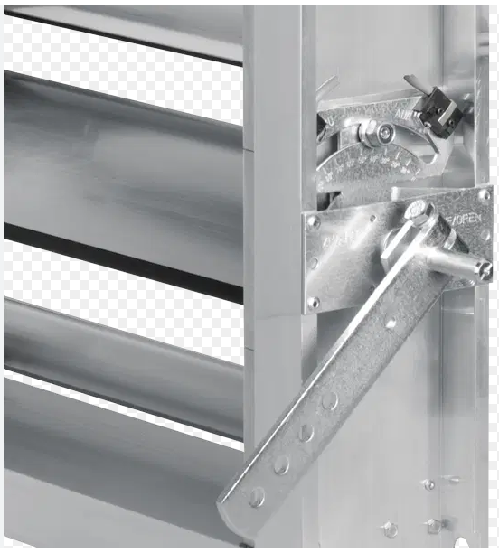
Verification devices damper position switch

Slide 22
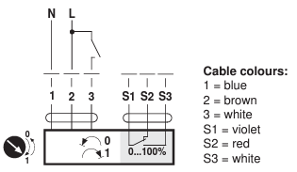
Verification devices damper actuator

Slide 23
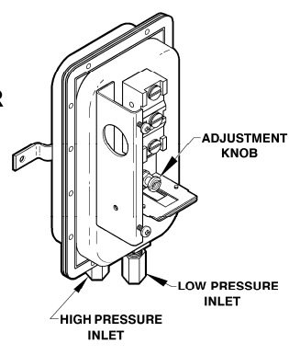
Verification devices differential pressure switch

Slide 24
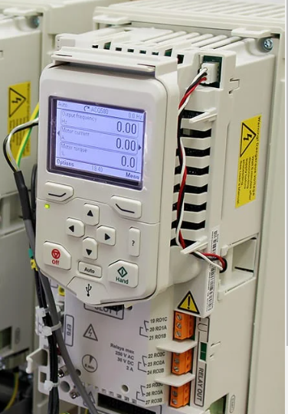
Verification devices variable frequency drive

Slide 25
Verification devices current relay

Slide 26
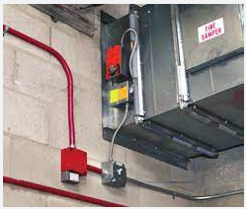
Verification devices power supervision

Slide 27
Inspections and testing
…Pressure difference testing and flow measurements
Performed by the air balance contractor and reviewed by the special inspector.
Primarily involves mechanical and controls subcontractors
Fire alarm contractor indirectly involved to initiate the sequence of operations and report device status from the fire command center

Slide 28
Inspections and testing
…Detection and control verification
Primarily involves the fire alarm, mechanical, electrical, and controls subcontractors
Special Inspector tasks:
Verifies the automatic sequence of operations
Verifies manual sequence of operations through the firefighter’s smoke control panel
Confirms supervision of power downstream of disconnects
After completing all tests, issues a testing report to the engineer of record.
Schedules final acceptance testing with the AHJ

Slide 29
Smoke control system design and testing 101
Best Practices
Installation
And
Testing

Slide 30
Best practices installation and testing
Step 1: Review the Rational Analysis (Smoke Control Report)
Identify the different smoke control zones
Confirm the type of smoke control in each zone (passive or mechanical)
Determine equipment status verification requirements
Study the sequence of operations
Examine the smoke control panel layout
If it is not in the report, check the mechanical plans.

Slide 31
Best practices installation and testing
Step 2: Find out who is providing verification (positive status) devices and the type:
Generally, fire alarm systems connect to verification devices provided by others. Includes:
Fans (differential pressure switches, VFD contacts, or current relays)
Dampers (limit switches, actuator contacts, other)
Power downstream of disconnects (contact in the switch or by other means)
Check the plans and specifications for requirements. If omitted, submit a request for information.

Slide 32
Best practices installation and testing
Step 3: Where is conduit required?
CBC Section 907.6.1.1 requires the fire alarm network in high-rise buildings to be, “Installed in enclosed continuous metallic raceways…” or in concrete.
Section 909.12.2 states, “…all wiring, regardless of voltage, shall be enclosed within continuous raceway.”
Confirm requirements with the Authority Having Jurisdiction

Slide 33
Best practices installation and testing
Step 4: Prepare fire alarm shop drawings
Determine quantities and locations of the following and show them on the shop drawings:
Initiating devices activating the smoke control sequence of operations
Control relays for fans, dampers, and other smoke control related equipment
Positive status devices required by CBC Section 909.12.1
Include:
Fire fighters smoke control panel layout.
Smoke control sequence of operations
Connection details
Conduit locations

Slide 34
Best practices installation and testing
Step 5: Obtain separate approval of the smoke control panel layout. Typical approvals are required by:
Author of the rational analysis
Smoke control special inspector
Fire department inspector assigned to the project

Slide 35
Firefighter’s smoke control panel

Slide 36
Firefighter’s smoke control panel

Slide 37
Firefighter’s smoke control panel

Slide 38
Mechanical test panel (los angeles fire department)

Slide 39
Mechanical test panel (los angeles fire department)

Slide 40
Best practices installation and testing
Step 6: Clarify details related to the weekly self test required by CBC Section 909.12.1.
If disruptive to building operations, the weekly self test can be bypassed
Requires approval from the Authority Having Jurisdiction
If approved, dedicated smoke control fans and dampers must be tested bi-annually along with power supervision of bypassed components

Slide 41
Best practices installation and testing
Step 7: Monitor progress in the field
Make regular site visits
Verify the installation of back boxes and enclosures needed for smoke control system interface
Coordinate with the general contractor in the fire command center, especially
Fire rated back boards for mounting equipment
Air conditioning
Power
Lighting

Slide 42
Best practices installation and testing
Step 8: Inspect the physical connections of fire alarm control and status modules to their respective fans and dampers. Be sure to coordinate with:
General contractor MEP Cordinator (if they have one)
Mechanical subcontractor
Electrical subcontractor
Controls subcontractor

Slide 43
Best practices installation and testing
Step 9: Pretest the system
Starts after permanent power is provided
Coordinate with the special inspector, general contractor and other trades
Use the smoke control panel to aid in pretesting
Test fans for on/off status and control
Test smoke control dampers for open/closed status and control
Test for supervision of power downstream of the disconnects.

Slide 44
Best practices installation and testing
Step 10: Test the System
Automatic sequence of operations
Manual override from the smoke control panel
Test fault conditions
Check operation of white status indicators
Weekly self test (as required)
Coordinate with the special inspector, general contractor and other trades
Make room for the air balance subcontractor. They will need access to the system for measuring pressure differentials, exhaust and airflow rates

Slide 45
Best practices installation and testing
Step 11: Final Acceptance
After the special inspector has accepted the system, be available to test the system again with the authority having jurisdiction. Additional changes may be required, depending on what they find.
Provide all required documentation, including test results, operating instructions, and as-built drawings. The special inspector will need those documents for their report to the Engineer of Record.

Slide 46
smoke control design and testing 101
Thank You

