Slide 1
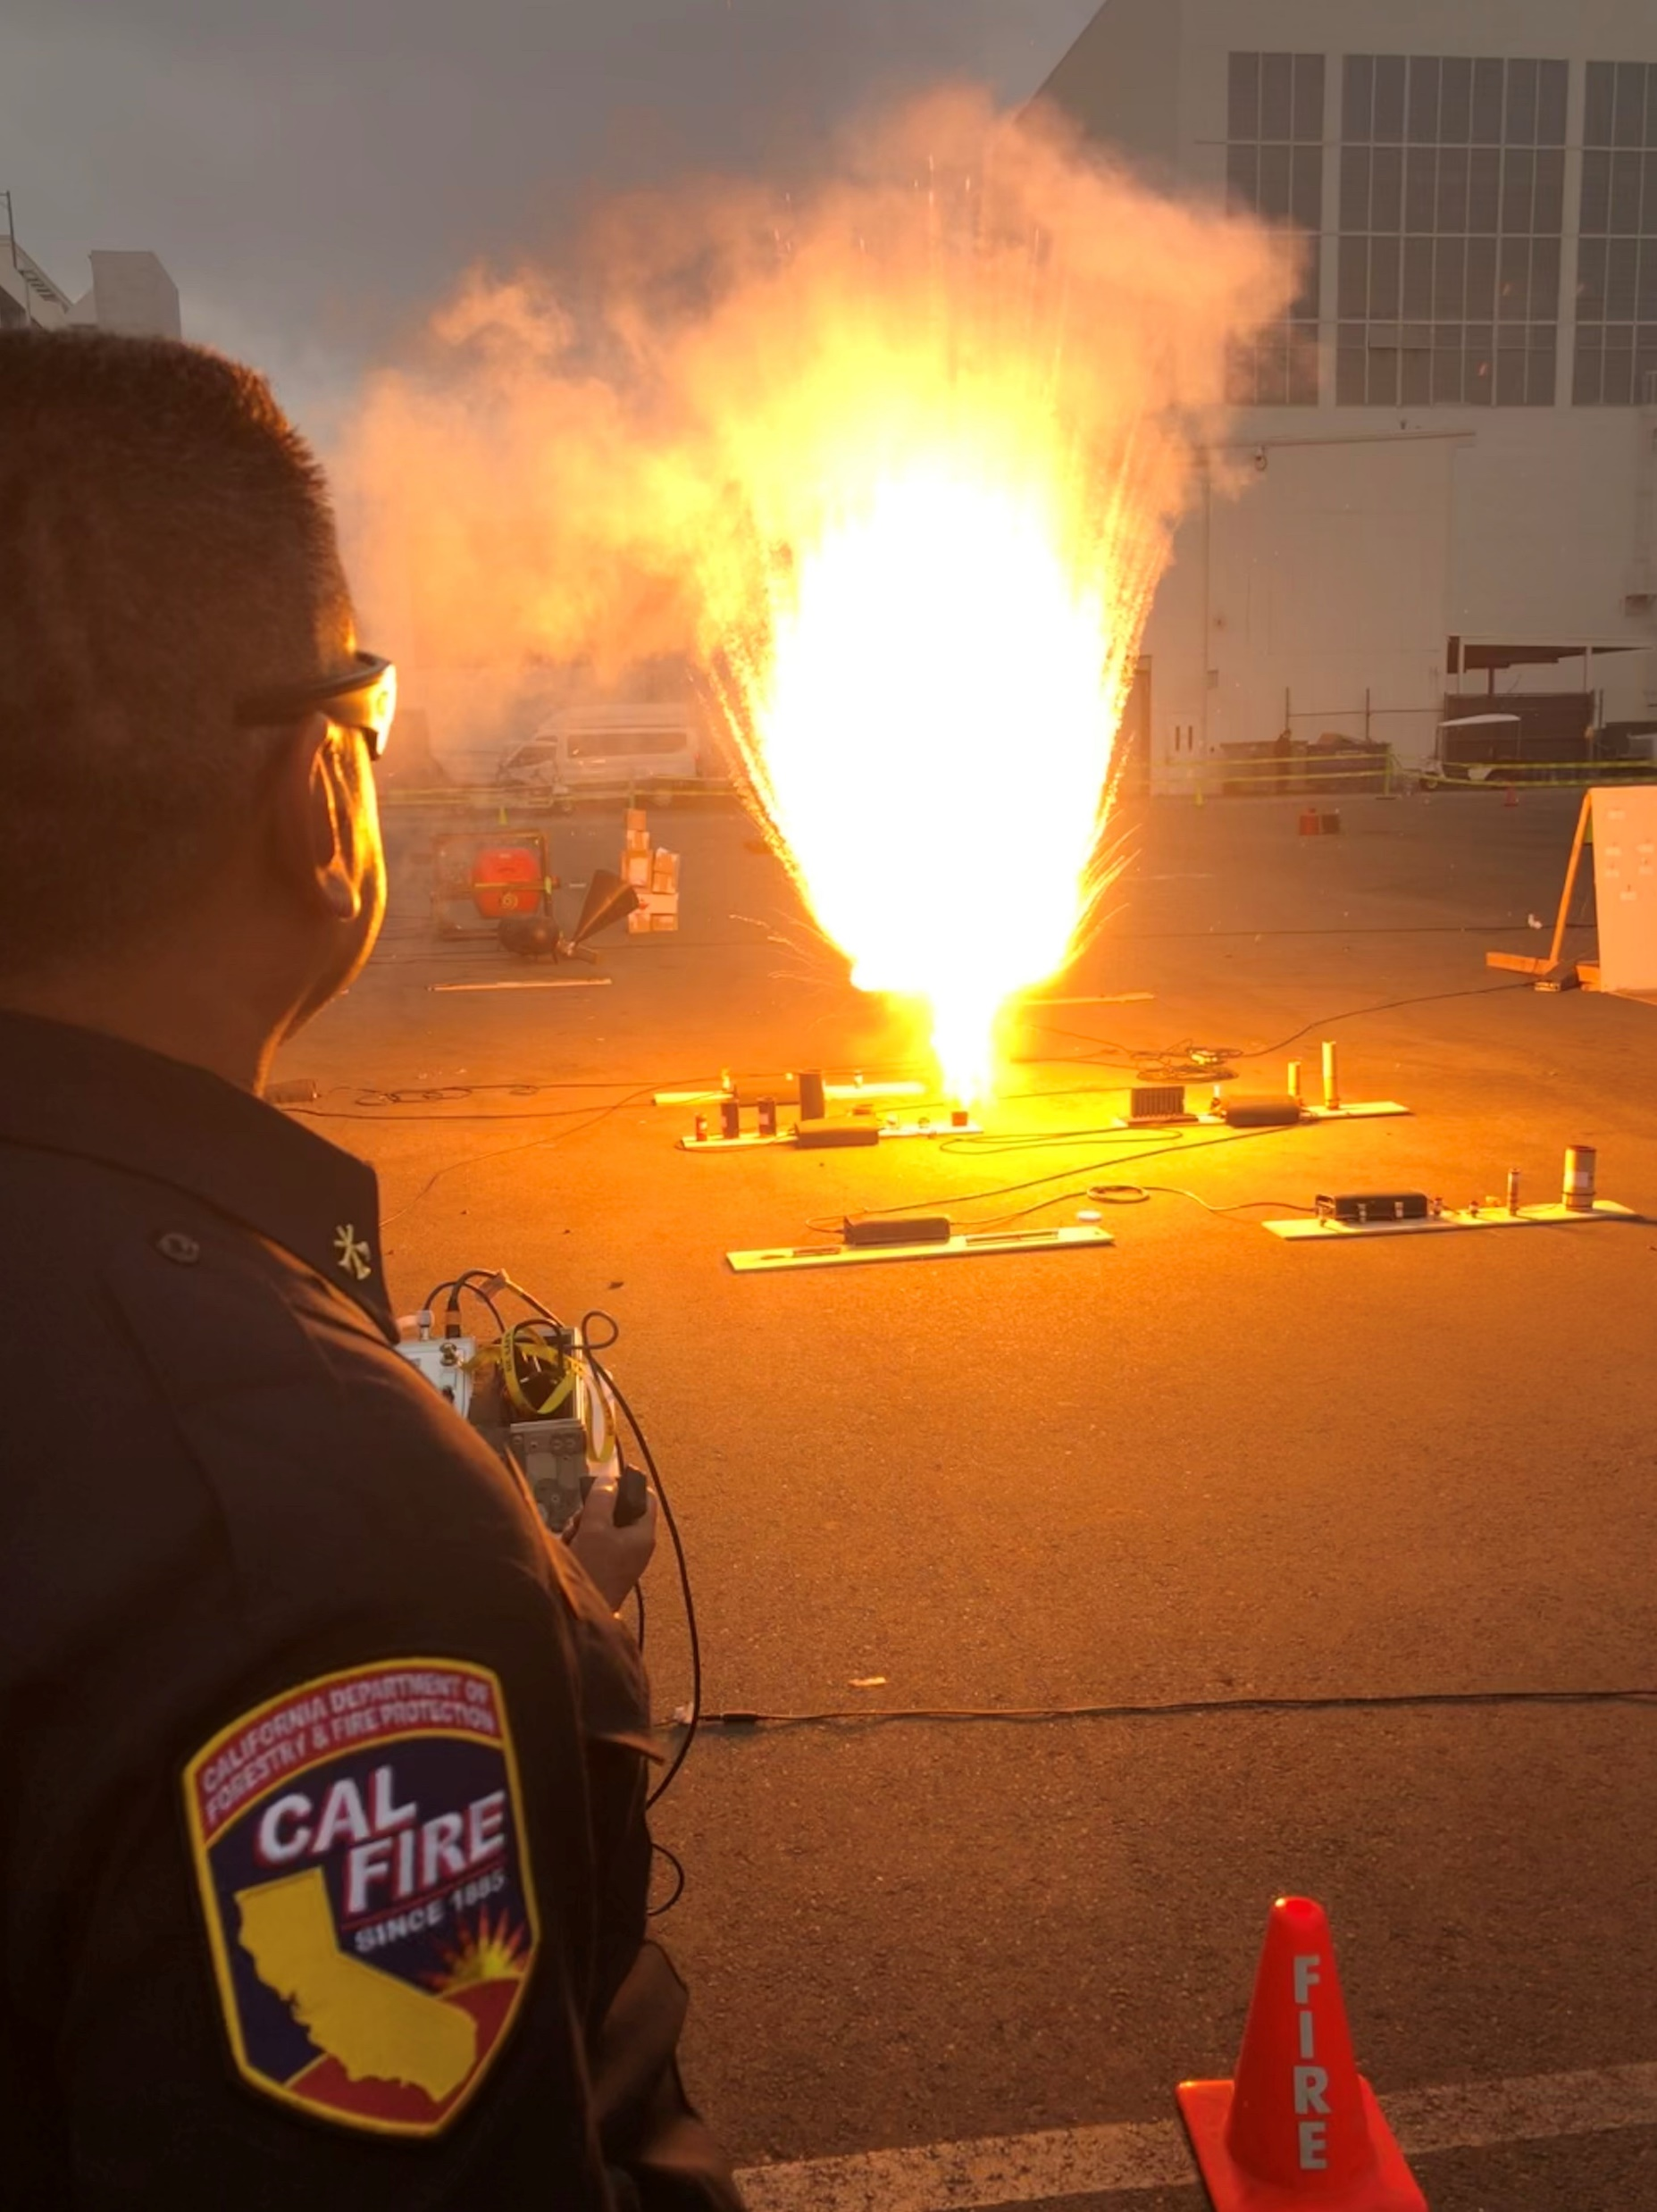
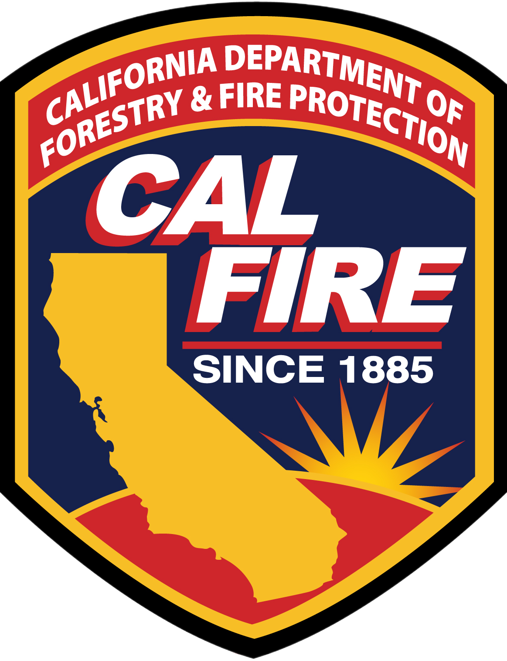
2022 Intervening Code Changes
Highlights from CCR Title 24
California Building Standards Code
Crystal Sujeski, Chief
Code Development and Analysis

Slide 2
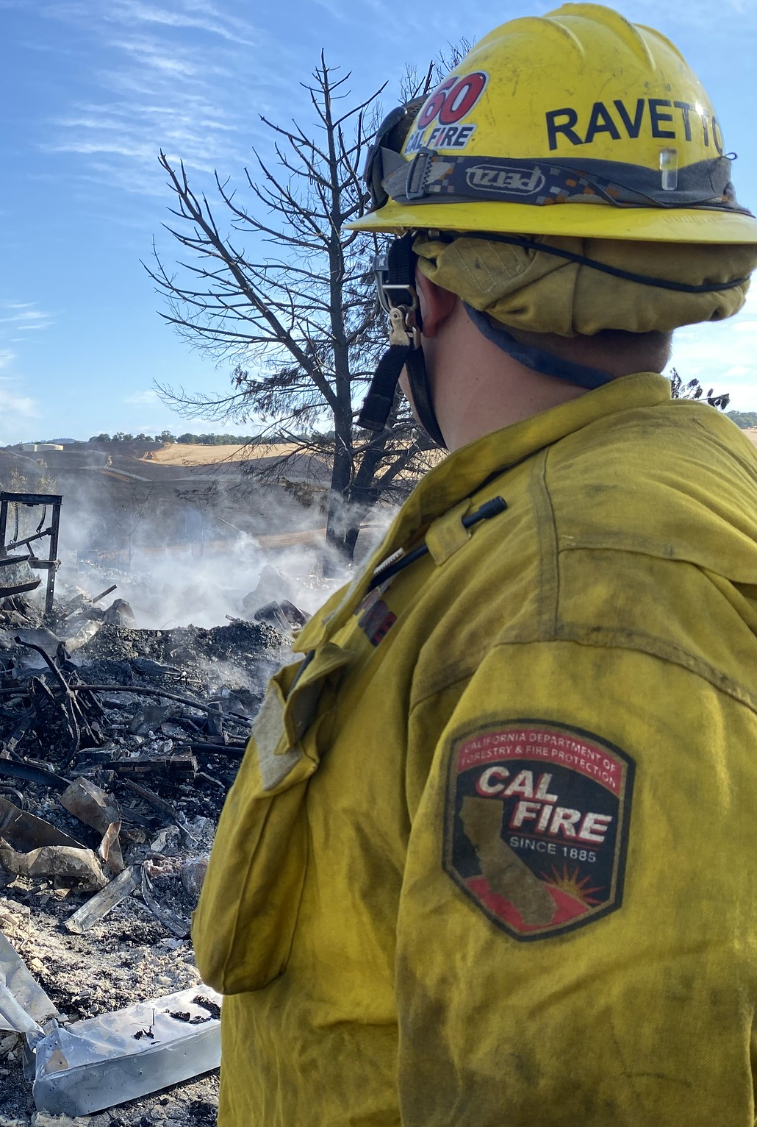
State Fire Marshal Authority to promulgate regulations

Slide 3
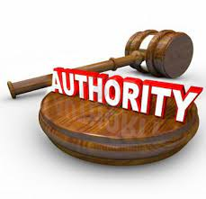
Health and Safety Code
The SFM holds the broad authority.
The SFM continuously reviews and updates with the latest industry standards and technological advancements.
Proactive approach with the collaboration with stakeholders, experts, and public entities this safeguards the SFM’s vital role in protecting the lives and properties of Californians from the treat of fire related incidents.
HSC 13108,13113, 13114, 13132, 13145, 13146, 13210, 13211, 16022.5, 17921, 18949.2;
GOV 51189;
EDC 17074.50;
etc.

Slide 4
Resources
Effective Date: July 1, 2024
California Building Standards Commission
https://www.dgs.ca.gov/BSC/Codes
International Code Council
https://codes.iccsafe.org
NFPA (Part 3 Electrical Code)
https://www.nfpa.org/codes-and-standards/all-codes-and-standards/codes-and-standards/free-access?mode=view
IAPMO (Part 4 and 5, Mechanical and Plumbing Code
https://epubs.iapmo.org/2022/CMC/index.html
https://epubs.iapmo.org/2022/CPC/
Publication websites

Slide 7
SFM and UC Memorandum of Understanding (MOU)
3-101. Purpose. The State Fire Marshal shall prepare and adopt building standards in the California Building Standards Code relating to fire and panic safety. The State Fire Marshal shall enforce these regulations in all state-owned buildings, specified state-occupied buildings, and state institutions, and, to the extent permitted by law, buildings administered or occupied by the Regents of the University of California. …
Notes:
The Rationale for this regulatory change is to make clear the intent of the HSC section 13146.
The law allows the State Fire Marshal (SFM) to designate a Campus Fire Marshal for the inspecting and enforcing fire and life safety standards on University of California (UC) Campuses. Specifically:
Authorizes the SFM to enforce the building standards and other regulations of the SFM on all UC campuses and properties administered or occupied by the UC.
Authorizes the SFM to delegate that authority to the person of his or her choice for each university campus or property who would be known as the Designated Campus Fire Marshal.
Requires any Designated Campus Fire Marshal to enforce those regulations and building standards relating to fire and panic safety.
Extends the authority to make written requests and perform inspections to a Designated Campus Fire Marshal.

Slide 8
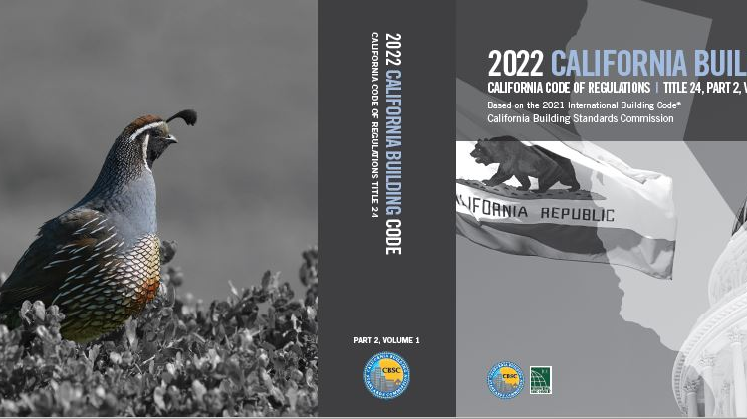

Slide 9
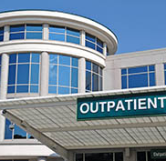
Delete reference to Group I-2.1
Joint OSHPD proposal
Remove the reference to I-2.1 and move forward with model code language for ambulatory care facilities.
Ambulatory care facilities are now classified as Group B occupancies.
Notes:
The SFM is proposing to delete the reference to I-2.1.
The SFM proposed amendment deletes the State of California provisions for occupancy Group I-2.1. The SFM proposed amendment adopts the model code provisions of the IBC identifying ambulatory care facilities as Business Group B occupancies. The SFM proposed amendment identifies the number of patients served by an ambulatory care facility as four or more. This number is consistent with NFPA 101 Life Safety Code criterion and IBC Sections 422.2 and 903.2.2.
Most of the current provisions in the IBC that regulate ambulatory care facilities correspond with the CBC provisions regulating Group I-2.1 occupancies and NFPA 101 Life Safety Code requirements for ambulatory health care facilities. Where on occasion, inconsistencies are a concern, additional SFM amendments have been proposed to amend IBC provisions regulating ambulatory care facilities.
Licensed ambulatory health care facilities that receive reimbursement for Medicare and Medicaid services are required to comply with the provisions of NFPA 101, The Life Safety Code, Chapter 20. Deletion of Group I-2.1 and regulation of these facilities as ambulatory care facilities is consistent with NFPA 101.
The SFM proposed amendment and associated amendments align CBC requirements with those of other applicable national standards. Conflicting requirements are a source of confusion for designers, owners, and code officials. Conflicting requirements are especially burdensome when owners are required to comply with applicable national standards that are more restrictive.
Eliminating inconsistencies between applicable codes and standards assists with the interpretation, understanding and compliance of building code requirements.

Slide 10
Section 307 High-Hazard Group H
Table 307.1(1)
MAXIMUM ALLOWABLE QUANTITY PER CONTROL AREA OF HAZARDOUS MATERIALS POSING A PHYSICAL HAZARD ^{a, j, m, n, p}
Notes:
This change coordinates the classification of high hazard with the change in definition to “flammable gas.” Category 1A flammable gases have an explosive component in that their deflagration index is extremely low. By comparison, Category 1B flammable gases with a burning velocity of 3.9 in/s or less have a very high deflagration index. Thus, there is a significant difference in the hazard level between the two flammable gas categories.

Slide 11
Group E Laboratories
Add an exception for Group E laboratories not classified as an H, if they are separated from the rest of the building by a one-hour fire partition. It is not the intent to limit the number of labs in schools, but in ensure they are separated.

Slide 12
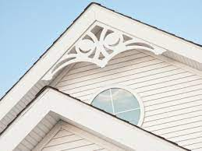
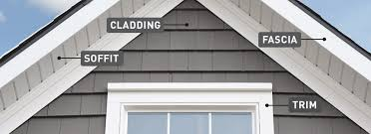
Wildland Construction (Ch.7A) Section 707A Exterior Covering
The SFM proposes to delete the exception to 707A.5, 707A.6, 707A.7, 707A.8 and 710A.2 for fascia and architectural trims.
Notes:
Through data collections, these features have been identified as adding the potential for fire spread to the building or structure, when exposed to wildfire embers. Several studies performed by The Insurance Institute for Business & Home Safety (IBHS) as well as data collected from CalFire damage assessment teams have identified that the fascia and other trim details will contribute to the fire spread of a building or structure when exposed to wildfire embers or radiant heat. These features originally thought to be too small to cause any significant damage, has been reassessed. Fire, like water will find the path of least resistance and cause more damage to the building or structure when allowed to be unprotected.
Attached Document A: Quarles2011_Vulnerability of Eves to Direct Flame and Radiation
Included is a report written by Stephen L. Quarles, Ph.D. which provides background data and research to support the proposal to remove the exception. This work presented here is document in the IBHS Research Report Near-Building Noncombustible Zone; page 11 of that report shows an image of the flames impacting the fascia/roof edge. The “previous research” mentioned here from Steve Quarles, including a proceedings paper from 2011 (attached) and in this post surviving-wildfire.

Slide 13
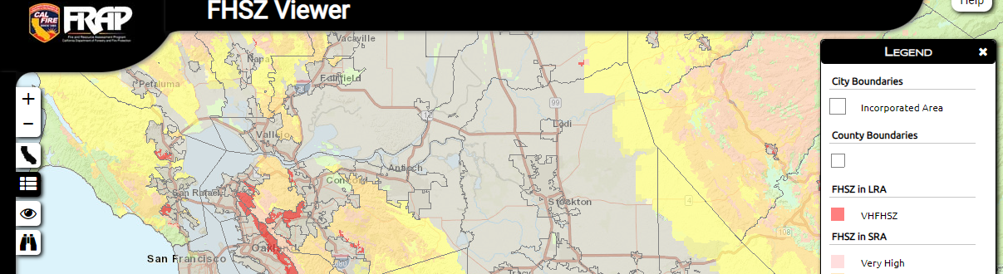
Model Ordinance for VHFSZ adoption
Adopt a model ordinance that provides for the establishment of very high fire hazard severity zones pursuant to the Health and Safety Code Section 51179.
Notes:
The purpose of the adoption of the model ordinance form is to comply with the mandates of the GOV 51179. This form is the minimum criteria of what shall be presumed as in compliance with the State with a Local Jurisdiction is adopting the Fire Hazard Severity Zones within its jurisdiction. The local jurisdiction shall provide the data as stated in the adopted form but may include additional information.

Slide 15
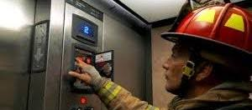
907.3.3.1 Hoistway fire detection.
Clarify the need for detection to remain in the hoistway for the activation of Elevator Phase 1 Emergency Recall.
Notes:
This section provides correlation with Section 607.1 of the California fire Code by making it clear that automatic fire detection devices used to initiate Phase I emergency recall of elevators are to be installed in accordance with both Title 8 Elevator Safety Orders and NFPA 72.
For the 2022 edition of NFPA 72, text revisions were made to 21.3.6.1 through 21.3.6.3 to avoid conflicts with ASME A17.1/CSA B44. The resulting language specifically prohibits the installation of smoke detectors in un-sprinklered elevator hoist-ways unless required by ASME A17.1/CSA B44 to initiate Elevator Phase I Emergency Recall Operation as specified in 21.3.14.1(2) and 21.3.14.2(2), or where required by other codes and standards for the actuation of elevator hoist-way smoke relief equipment. If sprinklers are installed in the hoist-way, then the smoke detector (or other automatic fire alarm initiating device) is necessary to provide the required recall feature.

Slide 16
Section 907.5.2.3.1 Public use area and common use areas
Add more specific clarifying examples where strobes shall be provided.
12. Shared office rooms used by two or more persons
13. Normally occupied room(s) used by two or more persons such as mother’s room, phone-room, quiet-room, wellness-room, etc.
14. Normally occupied storage room/area
15. Exam rooms in medical office buildings.
Code Interpretation 17-006
Question: Is it required to have a visual notification device in a private office with a guest chair as well? No
Notes:
There is already a SFM code interpretation requiring this. It is better to have this requirement in the body of the code rather than on an online code interpretation.

Slide 17
CFC-Chapter 12 ENERGY SYSTEMS CRC-Chapter 3 R328.5
TABLE 1207.11.4 MAXIMUM AGGREGATE RATINGS OF ESS
LOCATION | MAXIMUM AGGREGATE RATINGS (kWh) | INSTALLATION REQUIREMENTS
Within utility closets, basements, and storage or utility spaces located within dwellings | 40
In attached garages | 80
On or within 3 feet of exterior walls of dwellings and attached garages | 100
On or within 3 feet of exterior walls of dwellings and attached garages | 200 | Exterior walls and eaves are constructed with noncombustible surfaces ª
In detached garages and detached accessory structures | 200
In detached garages and detached accessory structures | 600 | Detached garage or detached accessory structure is a minimum 10 feet away from property lines and dwellings.
Outdoors on the ground | 200 | ESS is a minimum 3 feet away from property lines and dwellings.
Outdoors on the ground | 600 | ESS is a minimum 10 feet away from property lines and dwellings.
Notes:
The State Fire Marshal proposal is in alignment with California’s initiative to promote clean energy. A large percentage of the state’s electricity comes from renewable and zero-carbon sources. The increased demand for electricity warrants the need for larger Energy Storage Systems for use in residential occupancies.

Slide 18
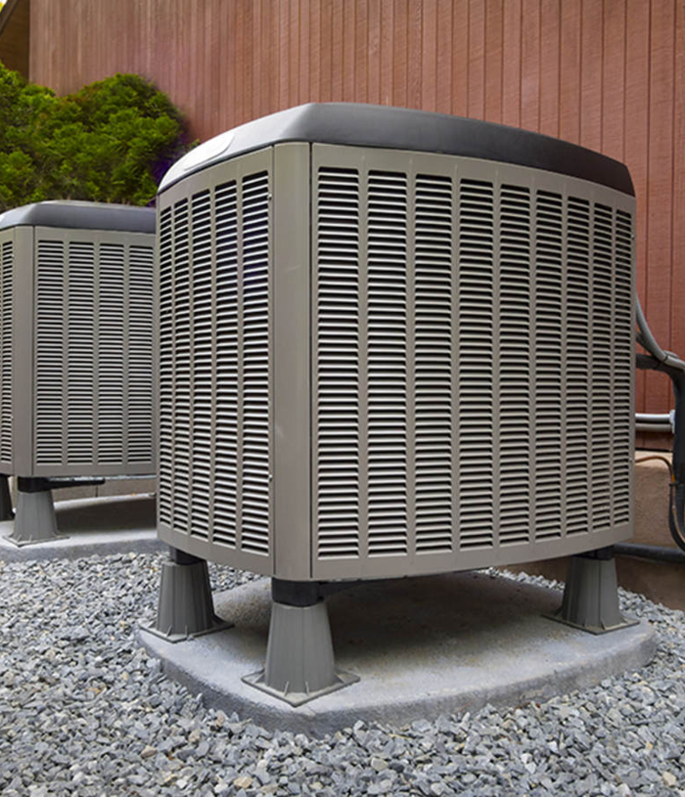
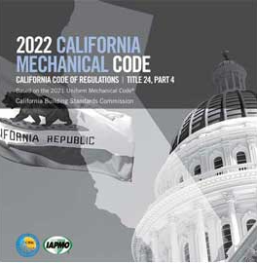
Part 4 Mechanical Code, Chapter 11 A2L Refrigeration

Slide 19
Chapter 11 A2L Refrigeration
What is A2L?
Benefits
A = Non-toxic
2 = Flammable
L = Low burning velocity
A2L refers to a class of refrigerants
2024 Uniform Mechanical Code
New equipment.
Enhanced Safety standards
Global Warming Potential (GWP) drastically reduced levels
Low impact on the ozone layer.
Some A2L refrigerants have higher cooling efficiency, so that less refrigerant is needed to service
Notes:
The scope of the Uniform Mechanical Code (UMC) A2L Task Group was to develop recommendations to further this technology, determine the methods available to address A2L exposure risk to public health and safety, expand on the usage and control of A2L refrigerants associated with mechanical systems and equipment, and address related issues such as flammability risk, toxicity, permissible exposure limit, leak detection systems, chemical compatibility and stability, and maintenance procedures for mechanical systems. The task group recommendations will be forwarded to the UMC Technical Committee for consideration in the development of the 2024 edition of the UMC

Slide 20
Reference Standards Updated to the latest editions
ASHRAE 15 (2022) Safety Standard for Refrigeration Systems
ASHRAE 34 (2022) Designation and Safety Classification of Refrigerants
ASTM E108 (2020a) Standard Test Methods for Fire Tests of Roof Coverings
NFPA 24 (2022) Standard for Installation of Private Fire Service Mains and Their Appurtenances, as amended*
NFPA 37 (2018) Standard for the Installation and Use of Stationary Combustion Engines and Gas Turbines
NFPA 409 (2022) Standard for Aircraft Hangars
NFPA 495 (2018) –errata Explosive Materials Code
NFPA 1225 (2022) Standard for Emergency Services Communications
UL 790 (Edition 9 2022) Standard Test Methods for Fire Tests of Roof
UL 60335-2-40 (4th Edition) Household and Similar Electrical Appliances

Slide 21
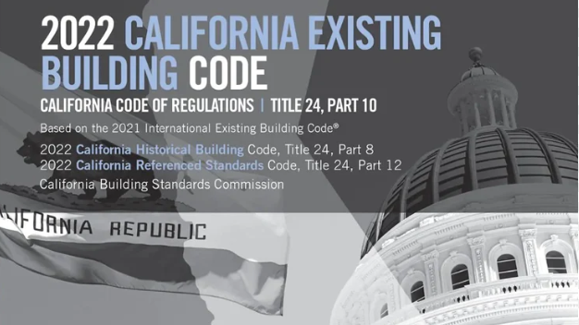

Slide 22
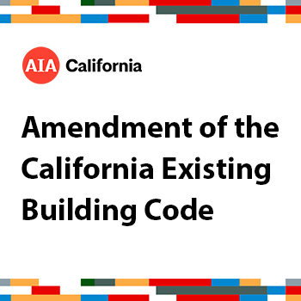
Part 10 Existing Building Code
Publish/Adopt Chapters 6-11 & 13.
Appeal from the AIA.
“Work-Area” method
Removed sections that would be conflict with statute and reduce fire safety
Performance Chapter 13 published/not adopted
https://aiacalifornia.org/amendment-of-the-california-existing-building-code/

Slide 23
Work Area Method
601.1 Scope. The provisions of this chapter shall be used in conjunction with Chapters 7 through 11. and shall apply to the alteration, addition and change of occupancy of existing structures, including historic and moved structures, as referenced in Section 301.3.2. The work performed on an existing building shall be classified in accordance with this chapter. Historic buildings and structures shall comply with Part 8, Title 24, C.C.R.
Exceptions:
1. [SFM] Use of Chapters 6-11 is not permitted in H, I and L, R-2.1, R-3.1 occupancies and high-rise buildings.
Notes:
The occupancies H, I and L have been removed from the adoption of the work area methods based on the analysis and complexity of these three occupancies. The additional risk factors of H, I, and L occupancies have additional safeguard construction requirements in the building codes to address life safety hazards. The SFM workgroup made a conscience decision to remove these three occupancies to meet the goals of the intended use of the work area methods.

Slide 24
Purpose of the Existing Building Code
The intent to bring in the work area methods is to create a compliance path for housing.
The purpose is to encourage the use and reuse of existing buildings while also maintaining minimum life safety requirements.
Three compliance methods
Prescriptive (Chapter 5)
Work Area (Chapter 6-11)
Performance (Chapter 13 [Printed/NOT Adopted in CA])
Notes:
The intent to bring in the work area methods is to create a compliance path for housing. The code enforcement community will be learning how to use the work area method. Even with the added benefit to designers, the enforcement community will require some training and time to incorporate ways to permit and track the proposed work area methods as a compliance path for existing buildings.

Slide 25
Prescriptive Method
The prescriptive method is essentially a duplicate of the provisions previously provided under Chapter 34 of the Building Code. Structural triggers are specified for additions, alterations, repairs, change of occupancy, and moved structures.
More administrative in nature
Is more simplistic than the Work Area Method
Existing materials- allowed unless unsafe
New materials – either compatible or complies with new code

Slide 26
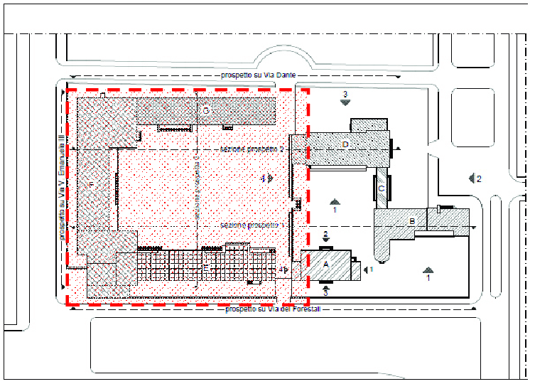
Work Area Method
The work area method is the most flexible of the compliance option and comprises Chapters 6 through 11 of the California Existing Building Code (CEBC).
It provides many benefits to building owners and design professionals, building on the premise that specific code provisions are only triggered if the scale and level of work warrant.

Slide 27
Notes:
The California Office of the State Fire Marshal hosted a webinar on August 29, 2022 to provide an overview of the International Existing Building Code with an emphasis on the work area method presented by Beth Tubbs, PE, FSPE Senior Staff ICC. International Code Council staff members are available to provide expert commentary and analysis on a broad range of building code and safety related topics. BIOGRAPHY Beth Tubbs is a senior staff engineer with the International Code Council Codes and Standards Development department. Tubbs joined the Code Council in 1995. She is involved in a variety of different activities including code development and support and participation in various committees both on a national and international level. Tubbs is the secretariat to the International Existing Building Code, the International Fire Code, and the ICC Performance Code. In addition, she is the lead staff member on the Fire Code Action Committee. Tubbs is a PE (Professional Engineer) in Massachusetts and California in fire protection engineering. She is a fellow of the Society of Fire Protection Engineers (SFPE) and a member of the board of directors for the Society of Fire Protection Engineers

Slide 28
Chapter 13 PERFORMANCE COMPLIANCE METHODS
As Chapter 13 of the 2021 IEBC is proposed to be printed in the 2022 CEBC, SFM proposes to amend a note under the chapter title clarifying that the Chapter 13 continues to not be adopted by the state of California and may be available for adoption by local ordinance and adding a reference to Section 104.11 for consideration of alternative means of compliance.
Why would you use it?
Increase energy efficiency
Increase electrification
Increase the use of renewable energy
Reduce greenhouse gas emissions
Increase the health of occupants
Notes:
Examples:
Healthy housing (e.g., require natural gas stove ventilation to improve indoor air quality).
Equitable energy (e.g., limit carbon emissions for apartments, condos and commercial buildings by improving energy efficiency or increasing renewable energy supply; reduce energy cost burden for low-income tenants).
Antidisplacement (e.g., prevent risk of displacement when improvements are made).
Resilience (e.g., make buildings and communities resilient to power outages).
Temperature (e.g., set maximum indoor temperature for heat wave resilience).
Determine and define goals, define the metrics and set targets, establish compliance cycles, set penalties, create training and maintenance

Slide 30
2023 SFM Legislative Changes
AB 835 (Lee, Chapter 345, Statutes of 2023) State Fire Marshal: building standards: single-exit, single stairway apartment houses: report
This bill requires the State Fire Marshal (SFM) to research standards for single-exit, single-stairway apartment houses, with more than two dwelling units, in buildings above three stories and provide a report to specified legislative committees and to the California Building Standards Commission by January 1, 2026.
Notes:
AB 358 (Addis, Chapter 83, Statutes of 2023) Community college districts: student housing
This bill excludes any California Community College (CCC) district building used as a residence for students attending a CCC campus from having to receive approval from the Department of General Services – Division of the State Architect, and also adds to the definition of “residential housing” any building used as a residence for students attending a campus of a CCC district.
AB 835 (Lee, Chapter 345, Statutes of 2023) State Fire Marshal: building standards: single-exit, single stairway apartment houses: report
This bill requires the State Fire Marshal (SFM) to research standards for single-exit, single-stairway apartment houses, with more than two dwelling units, in buildings above three stories and provide a report to specified legislative committees and to the California Building Standards Commission by January 1, 2026.

Slide 31
2027 Edition of International Codes
2024 Committee Action Hearings – Group A #1
April 7–16, 2024
Doubletree at the entrance to Universal Orlando
5780 Major Blvd Orlando, FL
2024 Annual Conference, Expo and Committee Action Hearings – Group A #2
Annual Conference: October 20–23, 2024
Expo: October 20–21, 2024
Group A Committee Action Hearings #2: October 23–31, 2024
Long Beach Convention Center
300 E Ocean Blvd Long Beach, CA

Slide 32
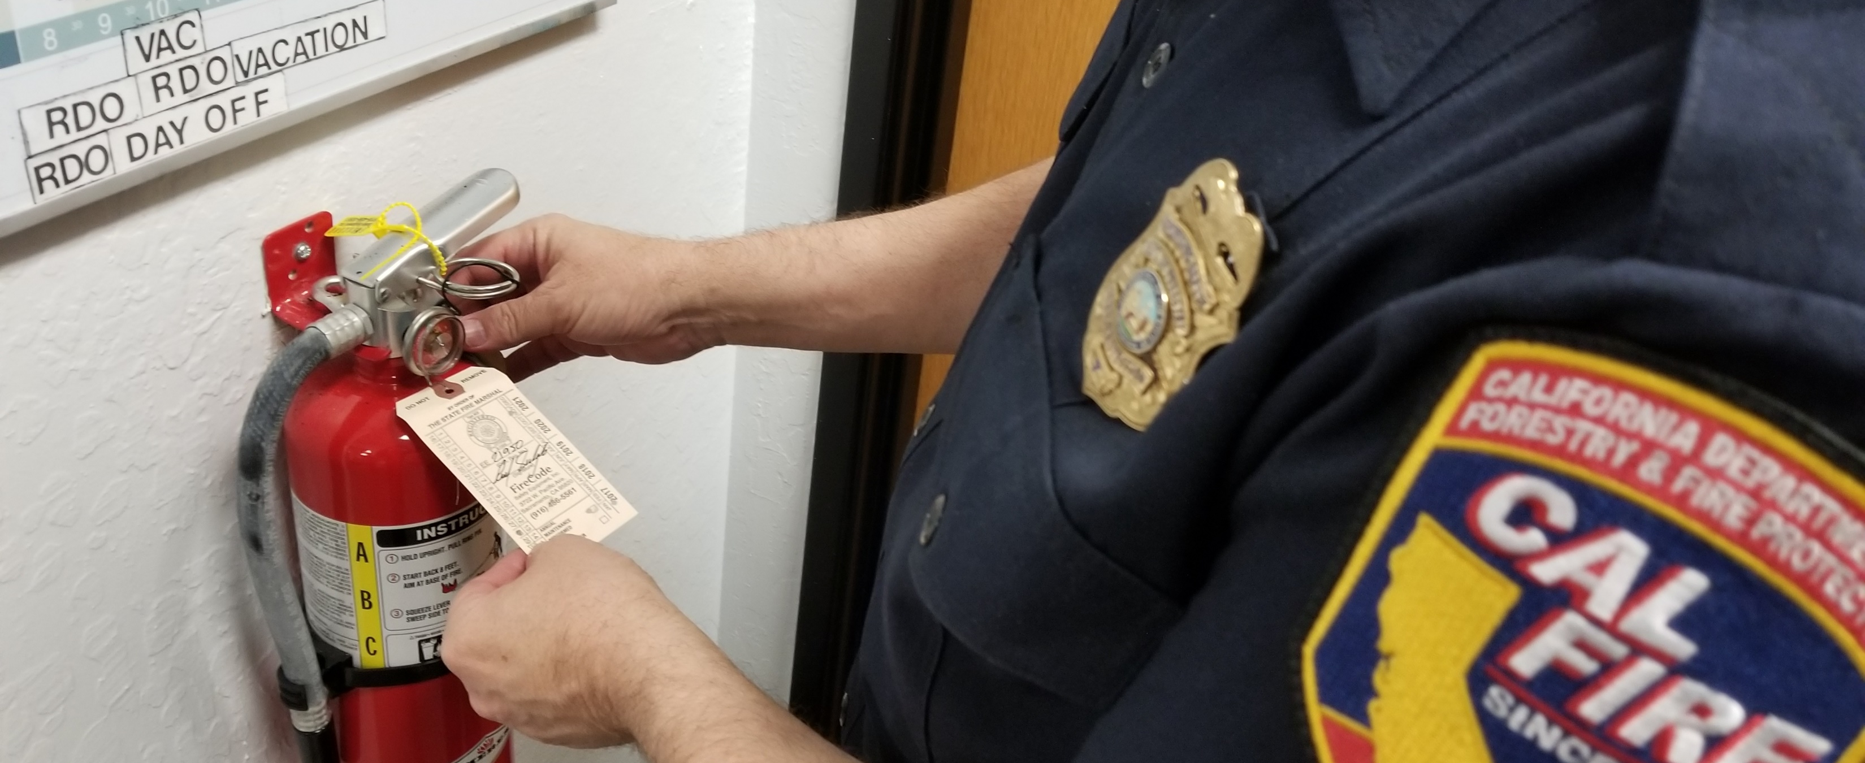
Questions?

Slide 33
Contact
Crystal.Sujeski@fire.ca.gov
510-8446-1276
Thank you!

